Slide 1
Learning from Serious Cases
Stephanie Nightingale, Designated Nurse for Safeguarding Children

Slide 2
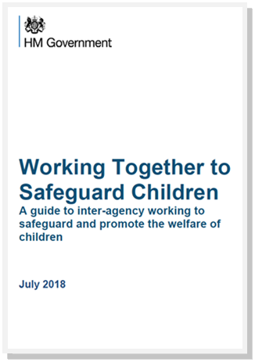
What makes a serious case serious?
Serious – Important, demanding thought, not slight or negligible
Case - Instance of things occurring
“Serious child safeguarding cases are those in which:
Abuse or neglect of a child is known or suspected
The child has died or been seriously harmed”

Slide 3
Staffordshire and Stoke-On-Trent Incidence
Babies under 1 year
August 2019 – March 2020:
Deaths – 4
Serious Injury – 3
April 2020 – May 2021:
Serious Injury – 2
Nationally, the most prevalent group to be notified are babies under 1 who have sustained serious injury *(The Child Safeguarding Practice Review Panel Annual Report 2021)

Slide 4
Abusive Infant Head Trauma
What do we know…..
>30 per 100,000 children
Median age of 4 months
Multiple Deprivation
Deteriorating Parental Mental Health
Financial Difficulties
Threats of Eviction
Criminal Proceedings
Misuse Alcohol & Substances
Domestic Abuse
Ages of concern: learning lessons from serious case reviews –
A thematic report of Ofsted’s evaluation of serious case reviews from 1 April 2007 to 31 March 2011
Findings:
Of the 471 SCRs evaluated by Ofsted concerning 602 children, 210 (35%) children were babies under 1 year.
Babies under 1 year have been subject of a high proportion of SCRs.
Key issues with timeliness and quality of pre-birth assessments; insufficient support for young parents.

Slide 5
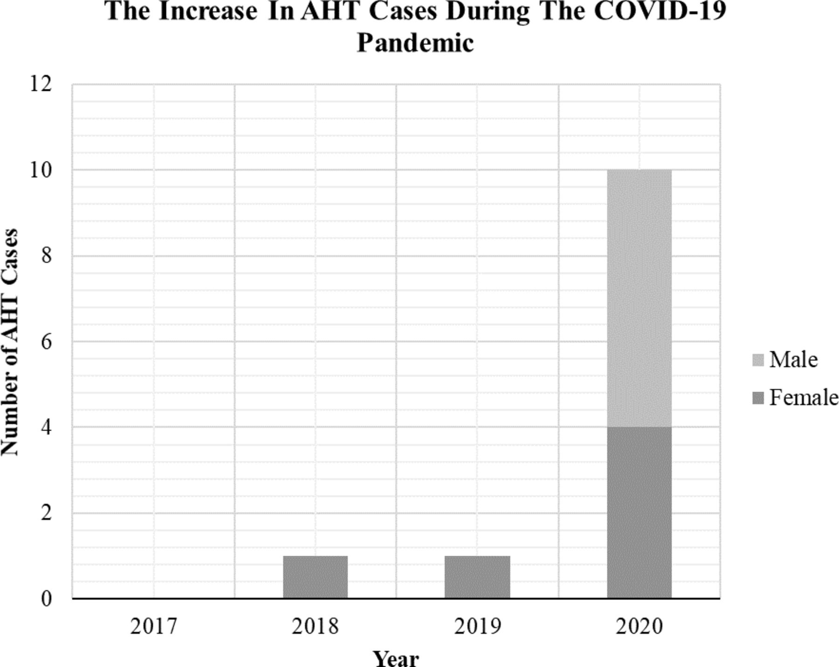
The Impact of Covid 19

Slide 6
Learning from Professionals, Parents and Systems

Slide 7
What have we learnt in Staffordshire & Stoke-On-Trent
0-2 year olds unrecognized (not knowing the ‘normal’)
- Early Help – referrals are low
Domestic abuse and babies
When consent is declined- what to do?
Escalation confidence, understanding and response (being heard as a professional)

Slide 8
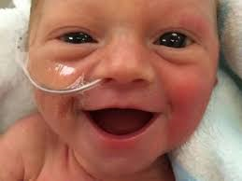
6 key practice themes to make a difference
1. Understanding what the child’s daily life is like
2. Working with families where their engagement is reluctant and sporadic
3. Critical thinking and challenge
4. Responding to changing risk and need
5. Sharing information in a timely and appropriate way
6. Organisational leadership and culture for good outcomes
**The Child Safeguarding Practice Review Panel Annual Report 2021

Slide 9
Food for thought…

