Slide 1
Implementation Panel : Q & A

Slide 2
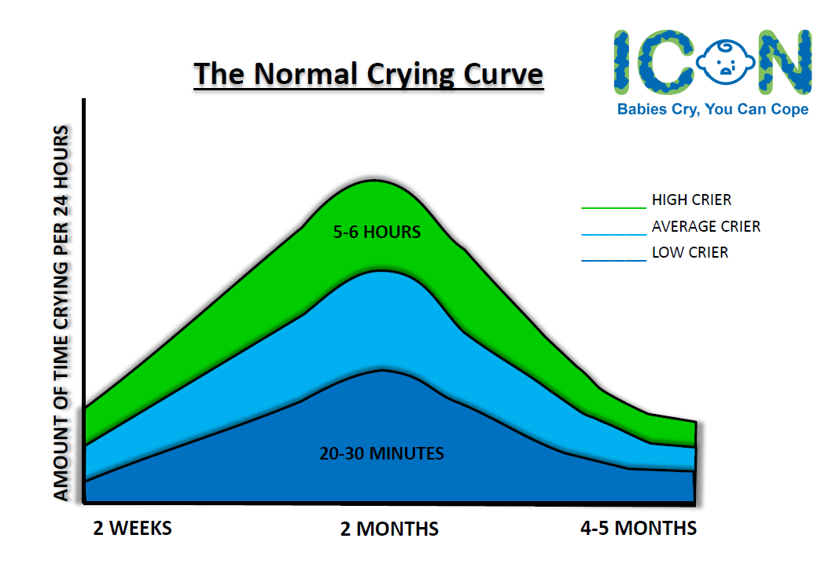
Implementation Team
Rebecca Sage – Nurse Practitioner for Child Death Overview Process South Staffordshire
Janey Merron – Designated Doctor and Named GP Safeguarding
Amanda Atherton – Safeguarding Nurse, MPFT
Mandy Stenson - Named Midwife for Safeguarding, UHNM
Louise Andrews-Gee - Commissioning Officer (Children & Families, Health & Wellbeing) Staffordshire County Council

Slide 3
QUESTIONS?
Where can I find the resources to use in delivering ICON?
Does any of the information come in different languages?
Can ICON be used as evidence in a child death review or rapid review that a practitioner has spoken to family about coping with crying and abusive head trauma? as
Is this parent education programme just for health professionals?

Slide 4
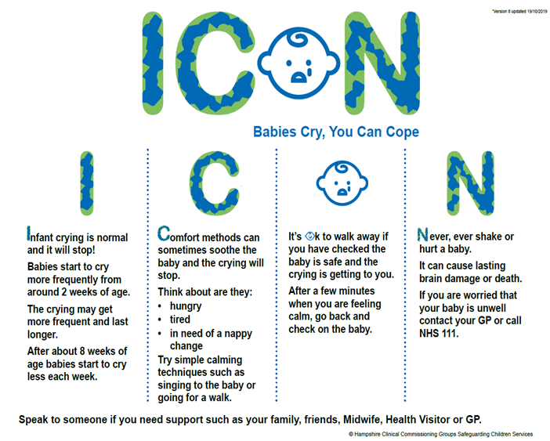
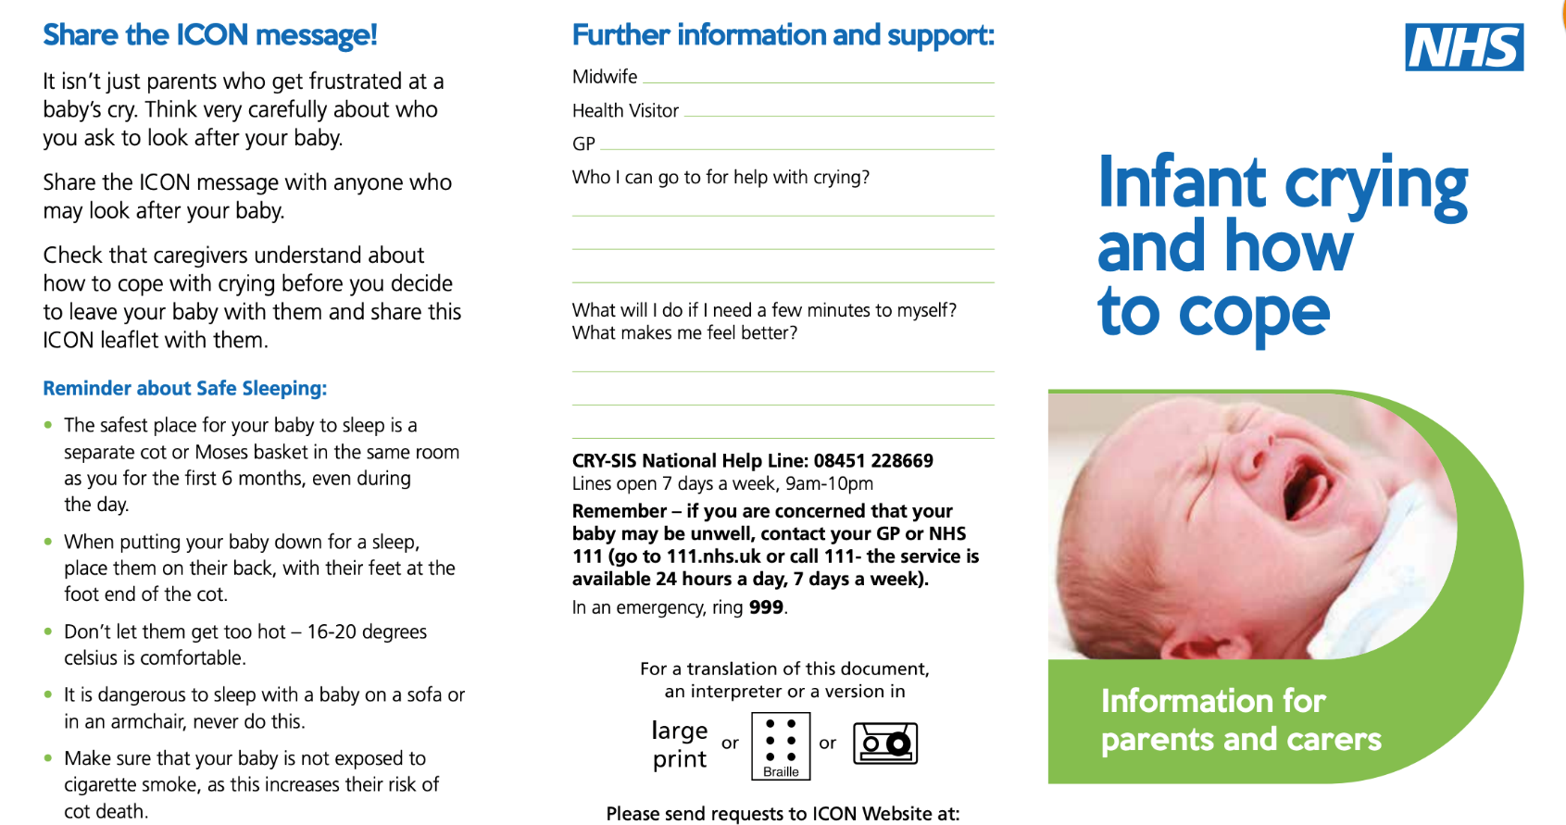
Resources
https://iconcope.org/

Slide 5
KEY CONTACTS:
Rebecca Sage Nurse Practitioner CDOP Rebecca.sage@nhs.net
Primary care: Dr Janey Merron ( jane.merron@nhs.net, text 07765256944)
MPFT: Amanda Atherton AmandaS.Atherton@mpft.nhs.uk
UHNM: Mandy Stenson Mandy.Stenson@uhnm.nhs.uk
UHDB: Pam Herrod (NB: UHDB will continue to use ‘Don’t shake the baby PEP in Maternity
services’) uptake of the campaign for wider departments is available and encouraged pamela.herod1@nhs.net
Public Health Staffordshire: Louise Andrews-Gee (louise.andrews-gee@staffordshire.gov.uk)
Public Health Stoke: Peta Curno Peta.Curno@stoke.gov.uk
Staffordshire safeguarding Children Board: Jude Russell
jude.russell@staffordshire.gov.uk
Stoke on Trent Partnership: Rachel Dodd Rachel.dodd@stoke.gov.uk

