Slide 1
Don’t forget about us….. Dads
By Kieran Davies (Social Worker) and Lisa Parkinson (Early Help Practitioner)
Notes:
Kieran

Slide 2
Who are we?
Kieran Davies
And
Lisa Parkinson
Notes:
Kieran

Slide 3
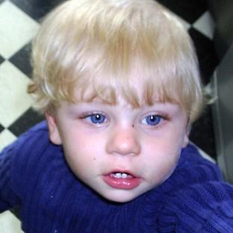
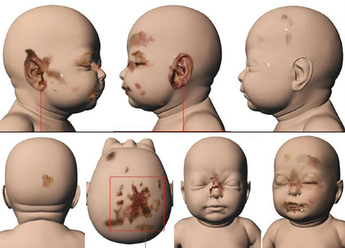
Peter Connelly
Where was Daddy?

Slide 4
Peter Connelly
17 months of age
Died in London 2007 following various missed opportunities to safeguard and protect
50+ injuries in just 8 months including this leading to child protection medicals concluding clear child abuse based on obvious injury’s
Repeatedly seen by social workers from London Borough Haringey children's services and the National Health Service
The bruising was repeatedly observed within a specific time scale
Mothers boyfriends brother was charged with the rape of a 2 year old child and moved into Peter’s home with a 15 year old female
Peters injuries included a broken back, broken ribs, mutilated fingertips, missing finger nails, various bruising and swelling and a tooth that was found after a post mortem after being punched in the face
Dad was never assessed as a carer
Tracey Connelly, Steven Barker and Jason Owen were convicted of Causing or Allowing the Death of a Child.
Notes:
Kieran
-Time line shows that mother entered that relationship in June 2006, moved in the partner (Steven) in November 2006 and Peter sustained injuries throughout 2007. Suggesting clearly who the perpetrator was. Died 3rd August 2007.
Jason Owen, brother to Steven, moved in with a 15 year old child. Information of a rape of a 2 year old child, later resulting in the child giving evidence and a conviction being achieved. Further information regarding Jason and Steven locking and abusing their 82 year old grandmother in a wardrobe to ensure she changed her will.
-Multiple professionals visited multiple times
We never asked the questions of the unknown males, their background, identify and family composition
Dad was not included in processes nor was he assessed as a potential carer and safeguard. He alerted them to the presence of Steven Barker.

Slide 5
Lessons learned….
The Voice of the Child
Adequate records need to be kept- Clarity!
Visits within statutory time scales and additional if required
Effective supervision
Professional curiosity/Challenging parents and carers
Background checks; Person who Poses a Risk to Children (PPRC), Police National Computer (PNC) and intelligence, Housing, Medical, Education, Employment (Position of trust), other local authorities, probation, CAFCASS, Domestic abuse etc
Sharing information within legal parameters (including parents being able to access information of a partner or potential part via Clare's law or Sarah's Law etc)
Birth Certificate
Chronologies
Notes:
Lisa
The voice of the child- we use the ‘all about Me’s’ , Genograms, Three houses etc Social Workers Tool Box
Supervision- Reflection, Peer support, Restorative Practice; Restorative Circle
Professional curiosity- does the parent or the information contradict one another? Disguised compliance
S17 Consent based, s47 no consent needed, Early Help is consent led
Birth certificates- PR, the legal responsibility to the child and the right to be informed about an assessment and the concerns raised about their child
Chronologies- Vital link consistent significant events and patters that can demonstrate abuse and/or neglect

Slide 6
Red flags for hidden men when children are significantly harmed or killed
Lack of information sharing between adult and children’s services
Relying too much on a mothers information
Judgements of parents/associates relationships
Overlooking fathers based on a mothers perception of an estranged father
Other children associated with the male- are they known to services and why?
Information gathering from all appropriate sources to ensure full clarity of a child’s daily lived experience, history and lifestyle
Notes:
Kieran
Lack of information sharing- professionals to be alert, sharing concerns, working multi-agency to ensure that there is full transparency
-Even if information feels insignificant, it can build a bigger picture for the child's live experience, see it, report it – Follow gut instinct
Listen to the child- partner etc
Guidance of sharing of information about people who pose a risk – remember how it overrides

Slide 7
How do we employ these skills into practice with dads and men?
Paternity, identity, their role within the child's life, Parental Responsibility
Assessing their ability to safeguard, protect, meet the child's care needs
Inclusion of men on parenting courses from prebirth and post birth (separately if required, Consider ICON)
Accommodating around working men’s commitments
Inclusion of the paternal family
Invitation to Child in Need meetings, Child Protection Conferences, Team Around the Family, Core Groups , inclusion of proceedings
Ensuring the relevant checks are completed on anyone who has a significant connection to a child
Notes:
Lisa
Paternity- Identifying the father and what they can offer and afford for a child's care and needs
Early Help Assessment, this can be completed by any professional. Child social work assessment and parenting assessments by social workers, to fully include fathers and their parental capacity.
Parenting courses- Bumps to babes, pre birth, post birth, simply play, pram to primary, parenting teenagers. Persistence, personalisation to that persons needs.
Paternal family- FGC to include fathers and family to make their own plan. Family meetings if there is not enough people or at Early Help threshold. Viability assessments if children are within the PLO or court process.
Meetings- held separately, information shared appropriately, being proportionate.

Slide 8
Continued…
Clarity of who the household members are upon each visit
Listening and considering a man’s perception, observation and feelings about their child and their role
Reflect and challenge your own assumptions and stereotypes of fathers
Personalise activities, engagement and communication methods to the father or child’s taste
Don’t be afraid to repeat sessions, advice and discussions
Consider the cognitive ability of the father, their experiences as a child with their childhood and services- build a relationship
Culture of mothers predominantly being the main carer, source of information, accompany to appointments- Valuing the father in these commitments
Working collaboratively with other agencies by linking the parent to their services
Notes:
Both KD to point 4 then Lisa
Clarity of who is in the household- asking the question on each visit, see if it changes? Who is there on each visit? Do they pose risks? Re-visit the genogram.
Reflect and challenge- consider all aspects of a fathers ability to meet the child’s need, history can change, observations, other agencies perceptions., consider his other children in other schools etc
Personalise- football activities etc- contact and letters
Repeating sessions- Delivering sessions in a various ways; consider putting it practically, explaining differently and leaning styles- consider the cognitive ability of the men

Slide 9
Do parents have rights to their child?
A barrister once said……
“Tell me what having parental responsibility is?”

Slide 10
Q&A
Thank you for listening, any questions?

Slide 11
Thanks for listening ☺

