Slide 1
Ellis's Story
Presented by Rebecca Sage and Amanda Atherton

Slide 2
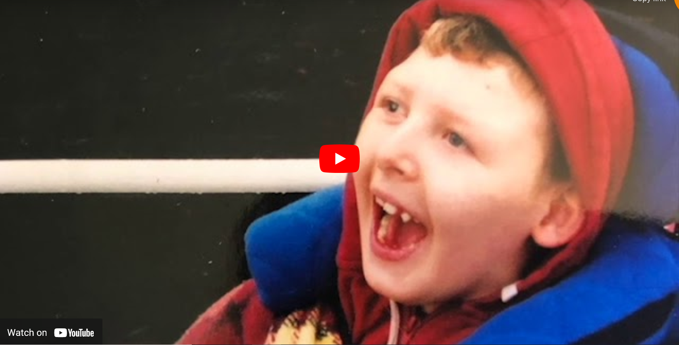
Ellis Story
https://youtu.be/aqCbREcduMA
Some may find this video distressing. Viewer discretion is advised

Slide 3
Reflection Points:
How did watching this video make you feel?
Was Ellis's story what you expected?
What did you learn?
Yourself as a frontline practitioners do you think you could have prevented this?
Based on watching the video how will you support families in the future?
What do you think your challenges/difficulties are?
Notes:
Consider professional responsibilty
Wider safeguarding concerns
Impact on professional- actions, prevention
Impact on family
society

Slide 4
What is ICON?

Slide 5
How can professionals help parents?
By offering ICON as a way to avoid a situation where frustration can lead to abuse
By discussing the issues raised
By talking through the key points in the ICON leaflet
Showing ‘I Am Unshakeable’ video

Slide 6
Implementing ICON
Research shows that AHT prevention programmes are most effective when the same message is given by different professionals on a number of occasions.
For those babies born prematurely or requiring neonatal intensive care, it is recommended that the Premature Baby ICON leaflet should be given to both parents and the ICON message discussed with them as part of the discharge planning for their baby
The ICON message can then be reinforced and parents supported by Health Visitors, specialist community neonatal nursing teams and GPs

Slide 7
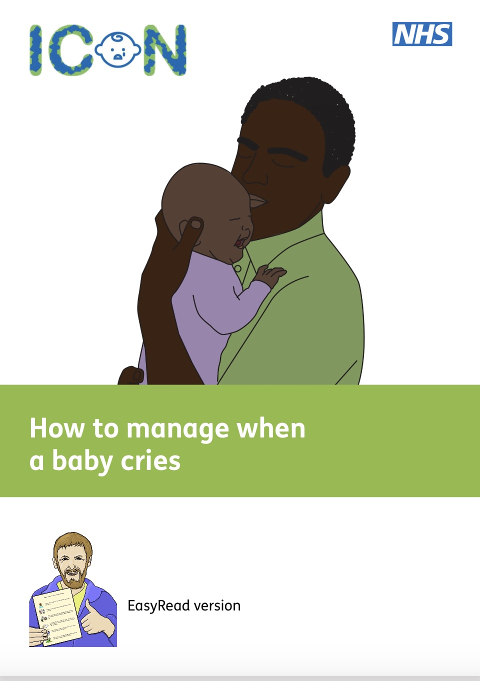
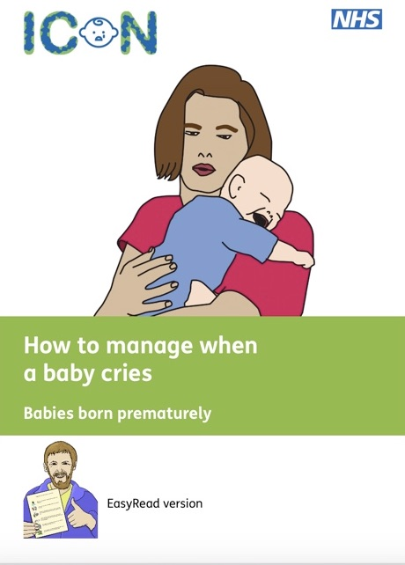

Slide 8
Implementation Team / Organisation link
Rebecca Sage Nurse Practitioner for Child Death Overview Process Rebecca.sage@nhs.net
Primary care: Jane Merron jane.merron@nhs.net
MPFT: Amanda AmandaS.Atherton@mpft.nhs.uk
UHNM: Mandy Stenson Mandy.Stenson@uhnm.nhs.uk
UHDB: Pam Herrod (NB: UHDB will continue to use ‘Don’t shake the baby PEP in Maternity
services’) uptake of the campaign for wider departments is available and encouraged
Public Health Staffordshire: Louise Andrews-Gee louise.andrews-gee@staffordshire.gov.uk
Public Health Stoke: Peta Curno Peta.Curno@stoke.gov.uk
Staffordshire safeguarding Children Board: Jude Russell jude.russell@staffordshire.gov.uk
Stoke on Trent Partnership: Rachel Dodd Rachel.dodd@stoke.gov.uk

Slide 9
Thank you!

